Slide 1

Hadoop

Slide 2

Agenda
Introduction to Hadoop
Hadoop nodes & daemons
Hadoop Architecture
Characteristics
Hadoop Features

Slide 3






What is Hadoop?
The Technology that empowers Yahoo, Facebook, Twitter, Walmart and others
Hadoop isn’t dead in the industry in fact it is very important in the industry
Hadoop is best for:
Parallel processing
Distributed computing
Hadoop

Slide 4
Big data tools
There are numerous tools for the big data
Databases: (Traditional ones and NoSQL)
Storage: (HDFS)
Processing of data:
Batch-wise: (Hadoop, Spark)
Real-time: (spark, Flink etc)
Data Analysis:
Data lakes
Data wareshousing: (Hives, snowflake)
Messaging queue: (Kafka)
Schedulers: (Airflow)
Cloud: (AWS, Azure, GCP)

Slide 5

What is Hadoop?
An Open-Source framework that allows distributed processing/computing of large data-sets across the cluster of commodity hardware
Particularly designed for batch data processing.
Isn’t capable of processing real-time data

Slide 6
What is Hadoop?
An Open-Source framework that allows distributed processing/computing of large data-sets across the cluster of commodity hardware
Particularly designed for batch data processing.
Isn’t capable of processing real-time data
Open Source
Source code is freely available
It may be redistributed and modified

Slide 7
What is Hadoop?
An Open-Source framework that allows distributed processing/computing of large data-sets across the cluster of commodity hardware
Particularly designed for batch data processing.
Isn’t capable of processing real-time data
Distributed Processing/computing
Data is processed distributedly on multiple nodes / servers
Multiple machines processes the data independently

Slide 8
What is Hadoop?
An Open-Source framework that allows distributed processing/computing of large data-sets across the cluster of commodity hardware
Particularly designed for batch data processing.
Isn’t capable of processing real-time data
Cluster
Multiple machines connected together
Nodes are connected via LAN

Slide 9
What is Hadoop?
An Open-Source framework that allows distributed processing/computing of large data-sets across the cluster of commodity hardware
Particularly designed for batch data processing.
Isn’t capable of processing real-time data
Commodity Hardware
Economic / affordable machines
Typically low performance hardware

Slide 10
What is Hadoop?
Open source framework written in Java
Inspired by Google's Map-Reduce programming model as well as its file system (GFS)

Slide 11





Hadoop History
Doug Cutting added
DFS & MapReduce
in
Hadoop defeated
Super computer
converted 4TB of
image archives over
100 EC2 instances
Doug Cutting started
working on
Doug Cutting
joined Cloudera
2002
2003
2004
2005
2006
2007
2008
2009
published GFS &
MapReduce papers
Hadoop became
top-level project
Development of
started as Lucene sub-project
launched Hive,
SQL Support for Hadoop

Slide 12
Vertical & Horizontal scaling
In your opinion what is the difference between vertical & horizontal scaling?
How much memory you can add to your existing machine?
Limited to some range.
RAM = 8GB
SSD/HD = 1TB
Adding extra memory or capacity to this existing system → vertical scaling
There is always a limitation of scalability
Hence, traditional DBs got failed for the use case where the data got very big
Existing System specs

Slide 13
Vertical & Horizontal scaling (Cont’d)
In an architecture, where a single machine gives instruction and other machines obey/follow these instruction.
For instance, if we have a system with a specs of 8GB of memory and 512GB of storage capacity. This is suitable for a sales data of say 10,000 customers.
If we gets higher data records e.g., 100k customers then this is too much for the system
How to handle this situation?

Slide 14
Vertical & Horizontal scaling (Cont’d)
There is two possibilities:
Enhance the existing system
Buy more machines
→ vertical scaling
→ Horizon scaling
Adding more machine in the existing infrastructure is called Horizontal scaling.
Master-Slave architecture
RAM = 8GB
SSD/HD = 1TB
RAM = 8GB
SSD/HD = 1TB
RAM = 8GB
SSD/HD = 1TB
RAM = 8GB
SSD/HD = 1TB

Slide 15
key things
There are two key things to be understand:
Distributed Storage
Distributed Computation
Distributed Storage:
Breaking down of data into smaller chunks and store it on the various machines
II. Distributed Comupting:
Process multiple parts of data on different machines
at the same instant of time

Slide 16
Drawbacks of non distributed computing
When we employ data processing on a single system without utilizing distributed processing, we encounter several challenges:
Capacity → Shortage of storing big data
b) No recovery → Automatic recovery of data isn’t possible upon system failure

Slide 17
Distributed storage
Cluster
RAM = 8GB
SSD/HD = 1TB
Master – Slave
architecture
RAM = 8GB
SSD/HD = 1TB
RAM = 8GB
SSD/HD = 1TB
RAM = 8GB
SSD/HD = 1TB
Master:
Too lazy ☺
Very bossy
Slave:
Performed everything that is asked

Slide 18
Distributed storage
If we want to store 18TB of data:
-- Can’t store this huge data on a single machine
-- Break the data into equal chunks i.e., each slave gets 6TB data.

Slide 19
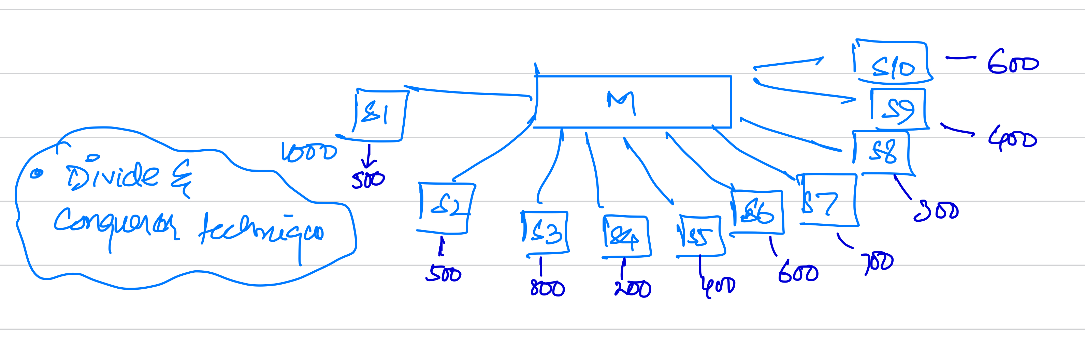
Distributed computation
Q: If we have a book having 10,000 pages. How much time one need to count the frequency of each word?
RAM = 8GB
SSD/HD = 1TB
RAM = 8GB
SSD/HD = 1TB
RAM = 8GB
SSD/HD = 1TB
RAM = 8GB
SSD/HD = 1TB
Not certain how much time
Now, if there are 10 friends to do the counting job

Slide 20
Distributed computation
Now, for instance if there is a word
“Hadoop” repeated 5000 times.
Each friend count “Hadoop” on their part of book → Divide
Add all the results → Conqueror

Slide 21

Hadoop Nodes
Nodes
Master Node
Slave Node

Slide 22



Hadoop Components
Hadoop consists of three key parts

Slide 23
Hadoop File system
It is a distributed file storage system.
This cluster is act like a “Single local machine
Instructions required in a framework to address the following queries:
Master Node
Slave Node 1
Slave Node 1I
Slave Node 1II
How to store data on this large cluster?
How the data will be partitioned?
How it will be replicated?

Slide 24
Hadoop File system
These sort of instruction are defined in the libraries that take care of these issues.
HDFS helps us to store data on Hadoop cluster in distributed format.
Master Node
Slave Node 1
Slave Node 1I
Slave Node 1II
Note: The slave has its own existing as well as the part of a Hadoop cluster e.g., Slave Node III has it own local file system as well.

Slide 25
Hadoop File system
Master Node
NameNode
Slave Node 1
Slave Node 1I
Slave Node 1II
DataNode I
DataNode II
DataNode III
Why we call it “Node”
It came from the reference of “Data Structure” concepts
such as decision tree or Graphs

Slide 26
Hadoop File system
DataNode (DN):
It is a commodity hardware (Slaves) to:
Store data
Process data.
Note: In cluster, there is always chances of failure of machine at anytime.
Failure could be due to:
Network issue.
Software glitch.
Power issue.

Slide 27
Hadoop File system
NameNode (NN):
Assign data to the various DN-I, DN-II etc.
Records the metadata of all the files in cluster.
Information regarding cluster health status.

Slide 28
Hadoop File system
NameNode (NN):
Assign data to the various DN-I, DN-II etc.
Records the metadata of all the files in cluster.
Information regarding cluster health status.
Metadata
Location of the block
Size of the files
Hierarchy of replicated data.

Slide 29
Hadoop File system
NameNode (NN):
Assign data to the various DN-I, DN-II etc.
Records the metadata of all the files in cluster.
Information regarding cluster health status.

Slide 30
Hadoop File system
NameNode (NN):
Assign data to the various DN-I, DN-II etc.
Records the metadata of all the files in cluster.
Information regarding cluster health status.
Cluster health
Datanodes are active and running (healthy cluster).
If any DN is down then this is called (unhealthy cluster).

Slide 31
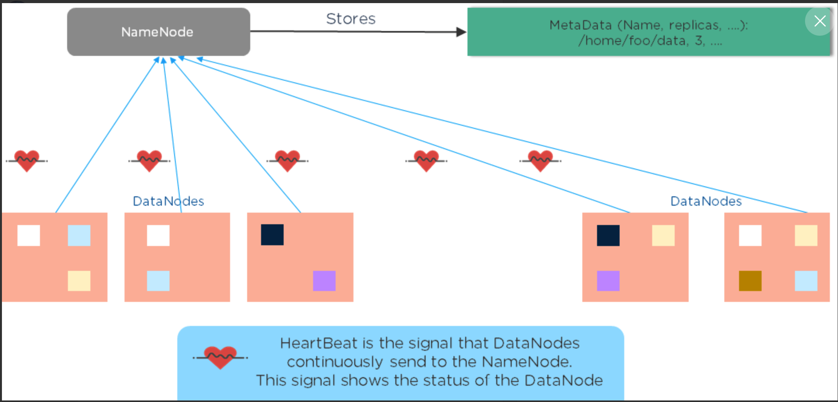
Hadoop File system
Source: www.Quora.com

Slide 32
Hadoop Daemons
Nodes
Master Node
Slave Node
Resource Manager
Node
Manager
NameNode
DataNode

Slide 33
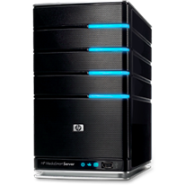

Basic Hadoop Architecture
Sub Work
Sub Work
Sub Work
Sub Work
Sub Work
Sub Work
Sub Work
Sub Work
Sub Work
Sub Work
Sub Work
Sub Work
Sub Work
Sub Work
Sub Work
Sub Work
Work
Sub Work
Sub Work
Sub Work
Sub Work
Sub Work
Sub Work
Sub Work
Sub Work
USER
Master(s)
Sub Work
Sub Work
Sub Work
Sub Work
Sub Work
Sub Work
Sub Work
Sub Work
100 SLAVES

Slide 34
Hadoop Characteristics
Distributed Processing
Open Source
Fault Tolerance
Easy to use
Reliability
Economic
Scalability
High Availability

Slide 35
Open Source
Source code is freely available
Can be redistributed
Can be modified
Free
Transparent
Inter-operable
Open
Source
Affordable
No vendor lock
Community

Slide 36



Distributed Processing
Data is processed distributedly on cluster
Multiple nodes in the cluster process data independently
Centralized Processing
Distributed Processing

Slide 37

Fault Tolerance
Failure of nodes are recovered automatically
Framework takes care of failure of hardware as well tasks

Slide 38
Reliability
Data is reliably stored on the cluster of machines despite machine failures
Failure of nodes doesn’t cause data loss

Slide 39

High Availability
Data is highly available and accessible despite hardware failure
There will be no downtime for end user application due to data
USER

Slide 40


Scalability
Vertical Scalability – New hardware can be added to the nodes
Horizontal Scalability – New nodes can be added on the fly

Slide 41
Economic
No need to purchase costly license
No need to purchase costly hardware
Open Source
Commodity Hardware
Economic
+
=

Slide 42

Easy to Use
Distributed computing challenges are handled by framework
Client just need to concentrate on business logic

Slide 43

Data Locality
Move computation to data instead of data to computation
Data is processed on the nodes where it is stored
Data
Data
Data
Data
Storage Servers
App Servers
Algo
Algo
Data
Data
Algorithm
Algo
Algo
Data
Data
Servers

Slide 44

Summary
Everyday we generate 2.3 trillion GBs of data
Hadoop handles huge volumes of data efficiently
Hadoop uses the power of distributed computing
HDFS & Yarn are two main components of Hadoop
It is highly fault tolerant, reliable & available

